Slide 1
GAMES DESIGN DOCUMENT (ART BIBLE)
Group members:
Will Foster (code)
Madeleine Coffey (3D/2D)
Callum Guyer (2D/3D)
Harry Rowland (2D/3D)

Slide 2
Initial idea:
Girl using umbrella to slowly drift down.
2.5 D Runner
Art styles to look at silhouette or cardboard.
Weather effects – is it raining? Girl in a storm perhaps.
Real or a dream?
Failing is hitting the ground.

Slide 3
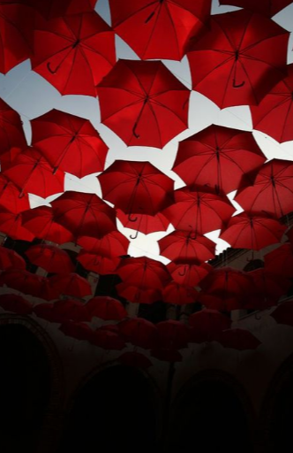
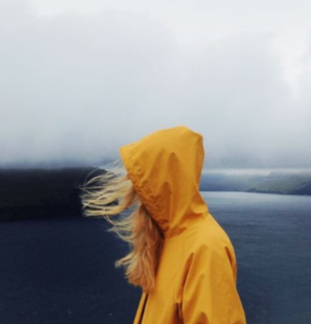
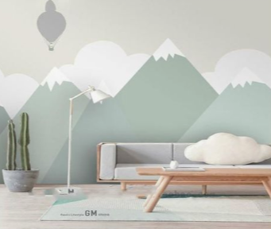
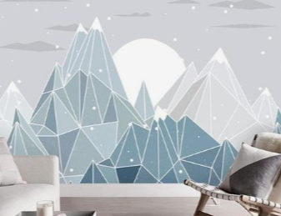


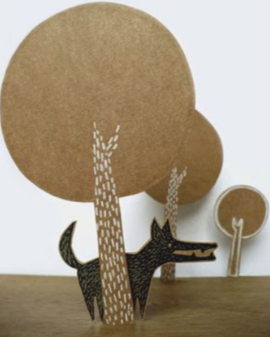
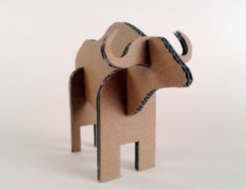
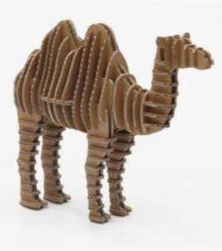
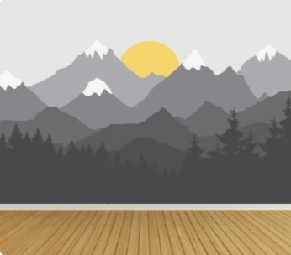
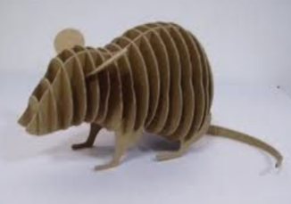

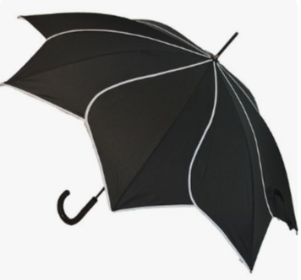
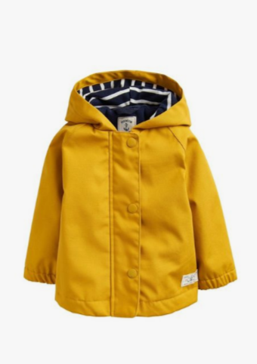
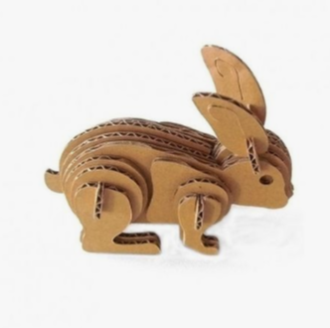
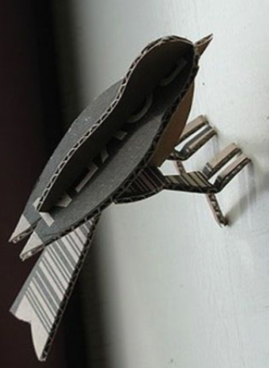
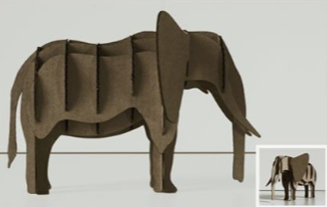
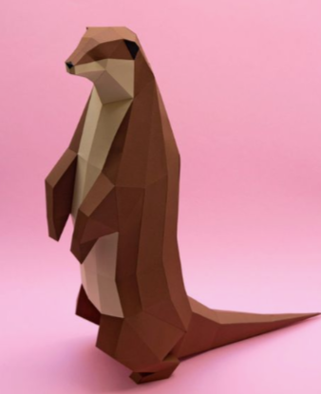

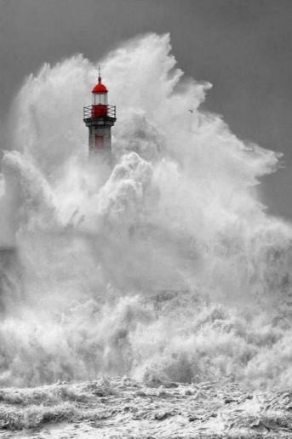
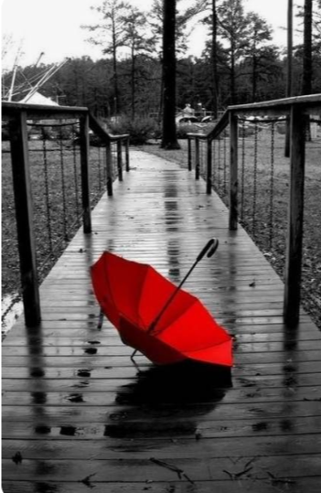
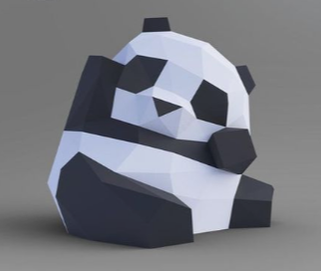
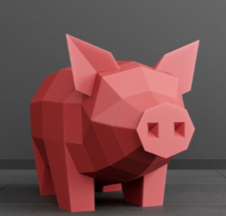
MOOD BOARDS
https://www.pinterest.co.uk/coffeym7204/year-2-game-mood-boards/

Slide 4
Goals and Stretch goals:
A 2.5D Runner/floater
Multiple obstacles such as a thunder cloud, a gecko that jumps at you.
Smooth character movement that falls faster with closed umbrella.
Wind animation (likely a 2D animation on a flat plane)
Polished character animation
Collectable jumps to boost the character into powerups etc.
A range of animated animals that either help or hinder the player.
Snowy regions that create a faster fall.
Changing lighting with day and night to indicate there is time progression.
Increasing difficulty with more “enemies” spawning the longer you stay in the air.

Slide 5
Insert one sheet here

Slide 6
Insert character concept here

Slide 7
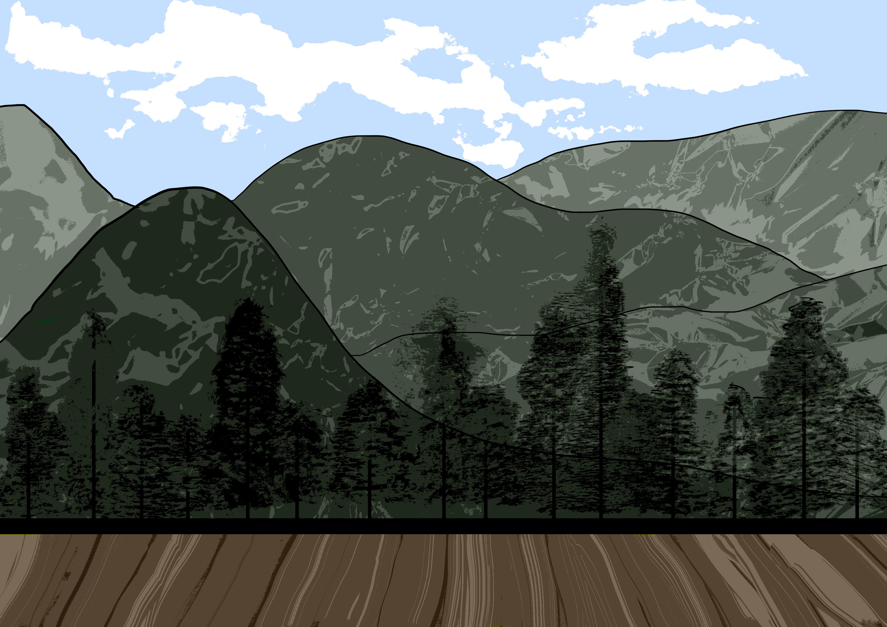
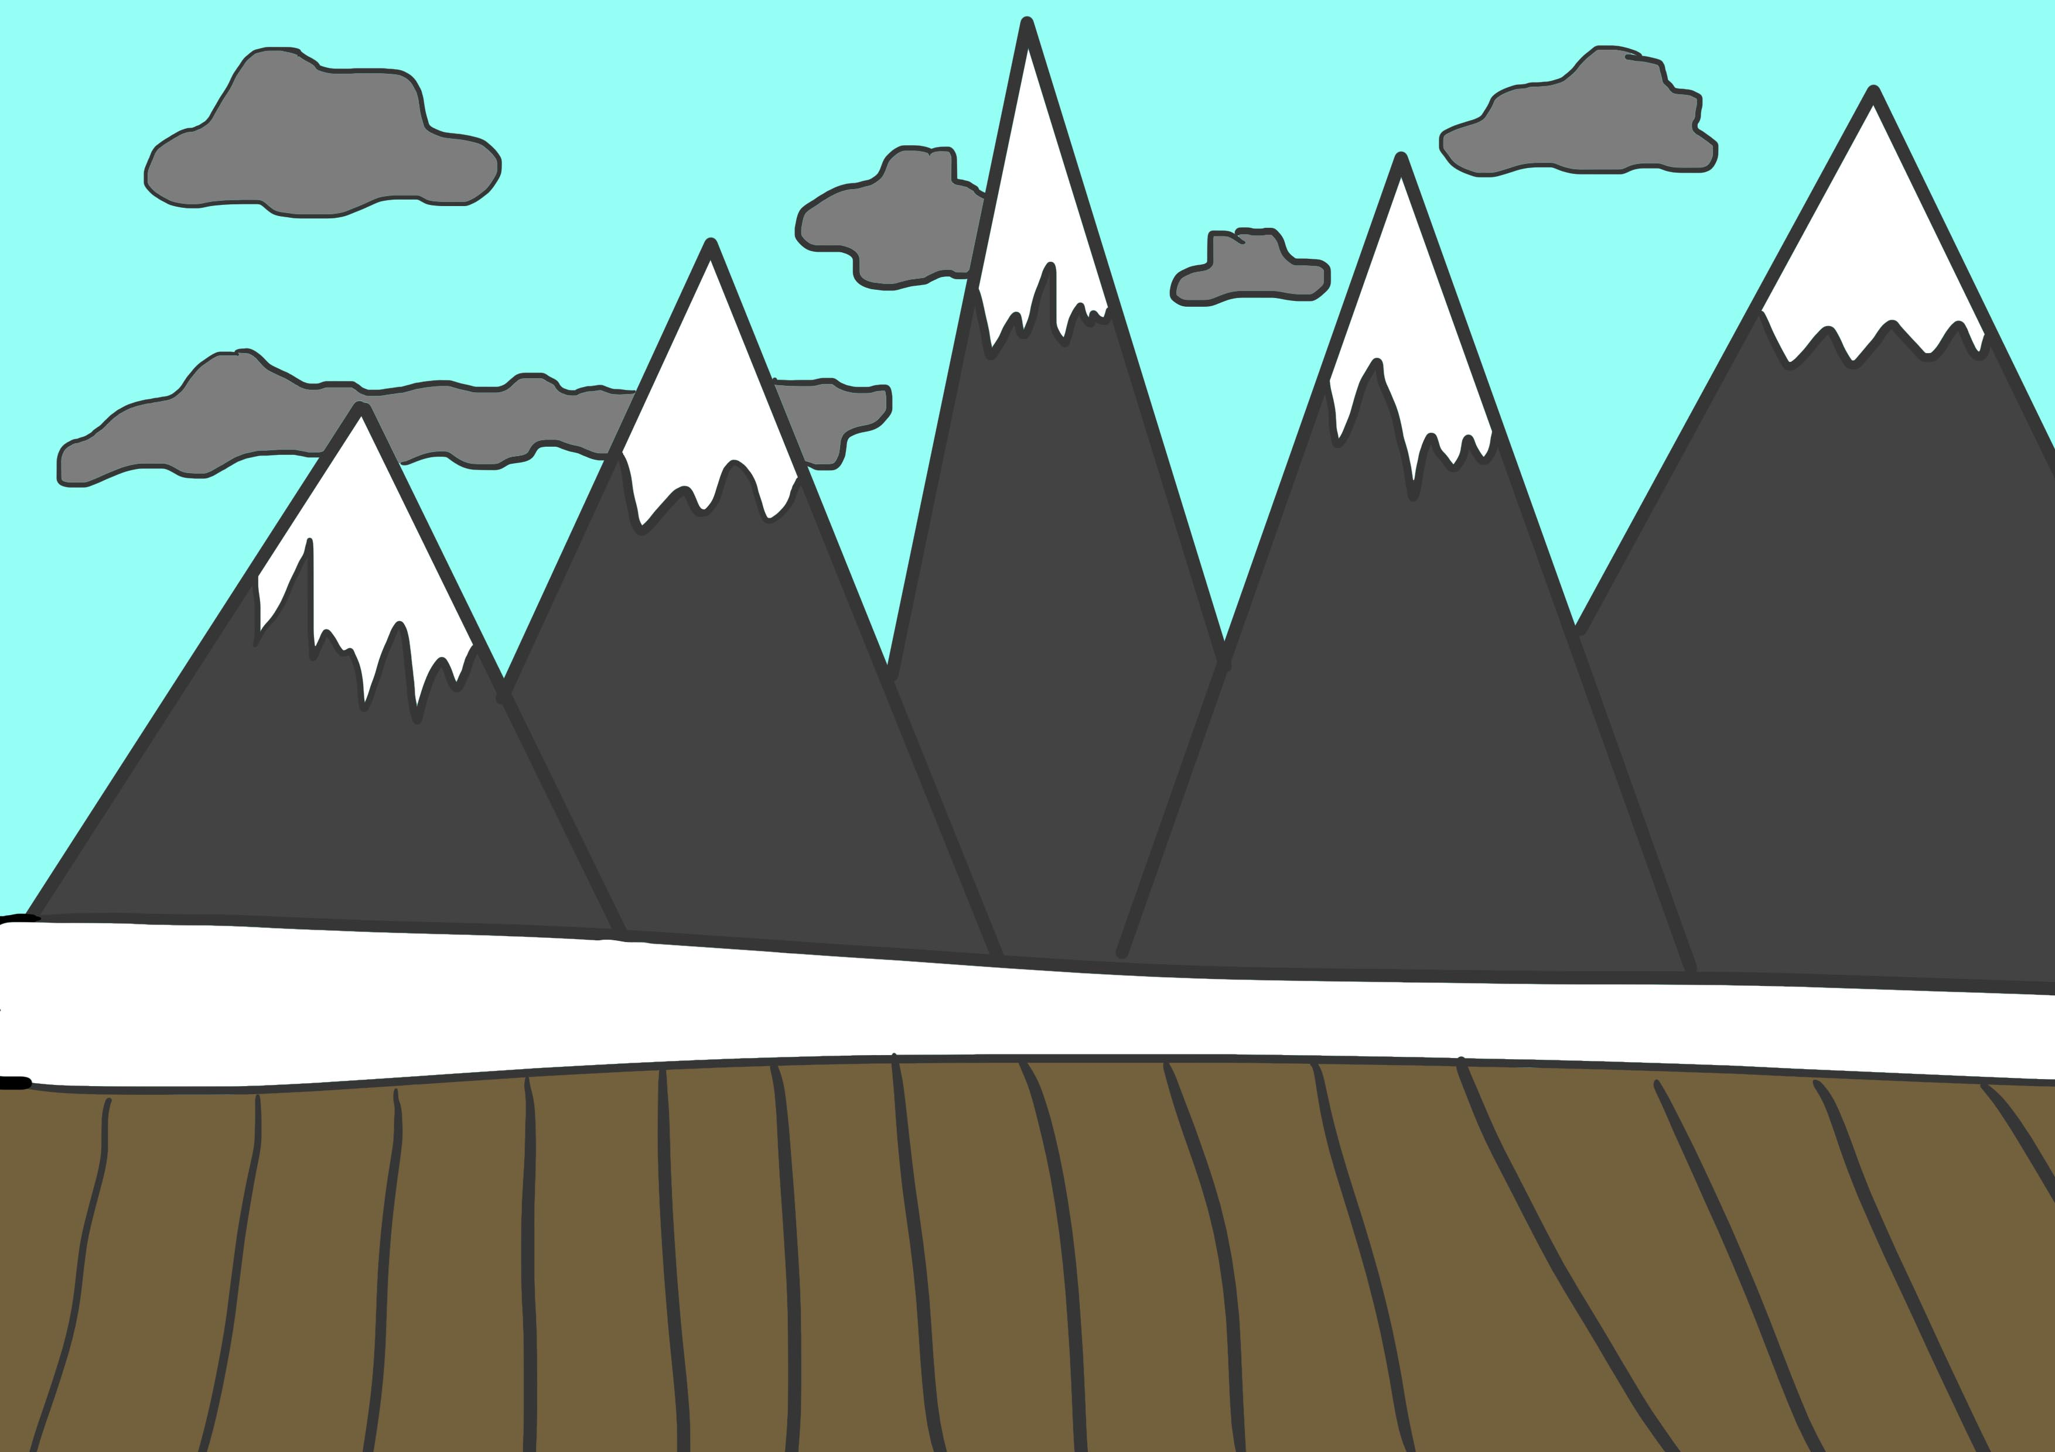
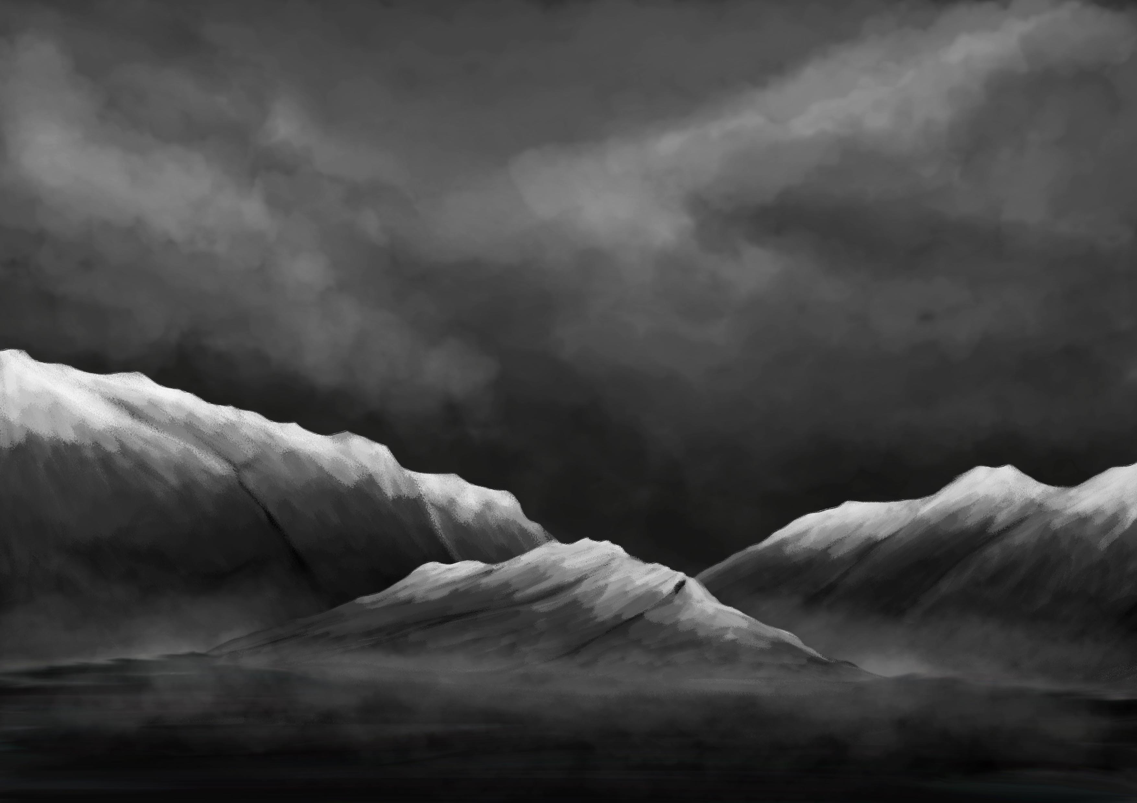
Background Concepts
The background could be a long repeating image on a vertical 2D plane, the trees could be on planes that are closer to the character to give a sense of distance.

Slide 8

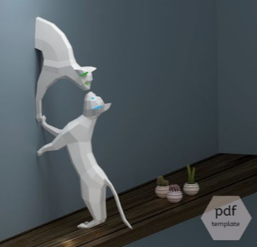
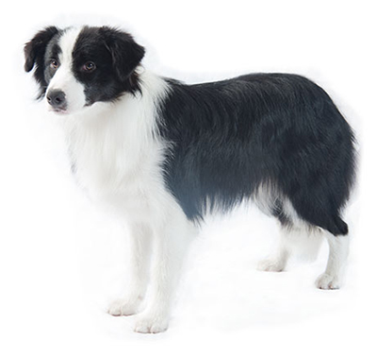
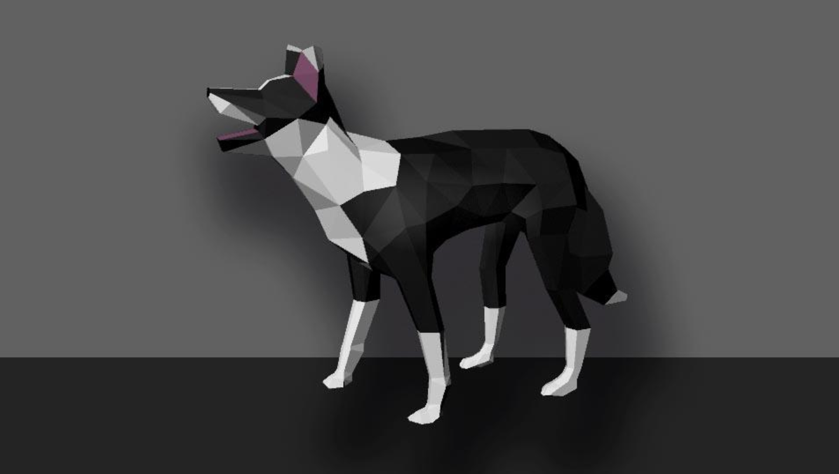
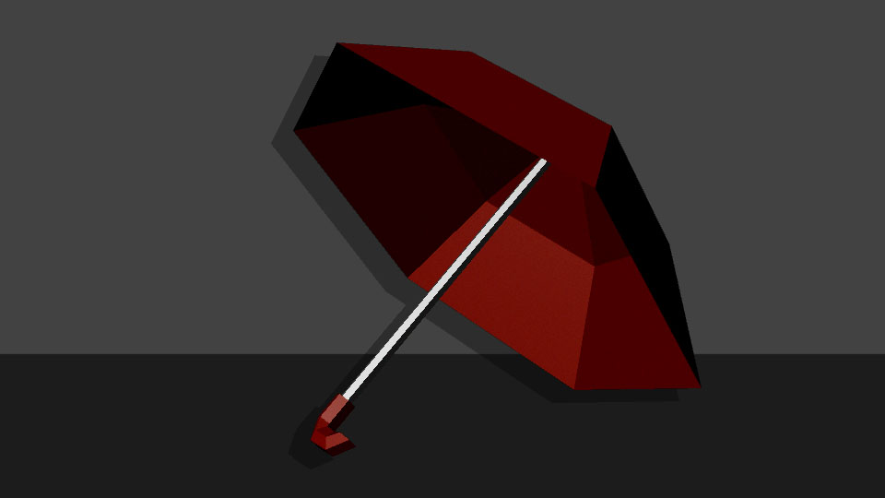
3D model experiments
Inspiration:
52 poly umbrella, took about 10 minutes to make
Border Collie, around 800 poly which is way to high for the game, will be less if we don’t triangulate the models. A lot of the polys were in the paws and the face, so rethinking those should take the poly count right down. Took about 4 hours.

Slide 9
Insert early unity grey box prototype here

